Slide 1
Spectral Imaging
Imaging Instrumentation

Slide 2
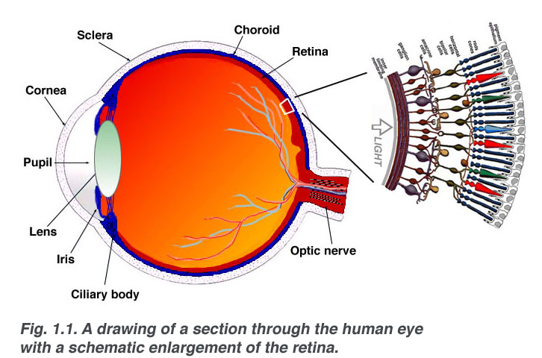
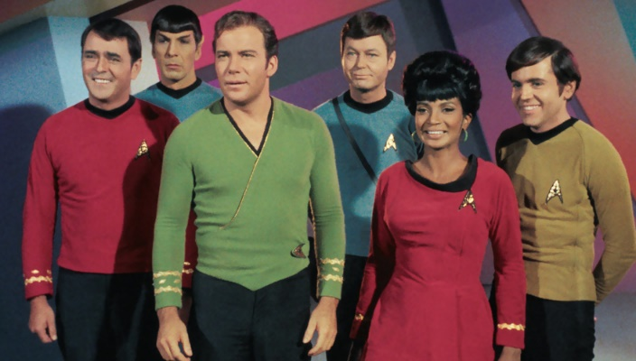
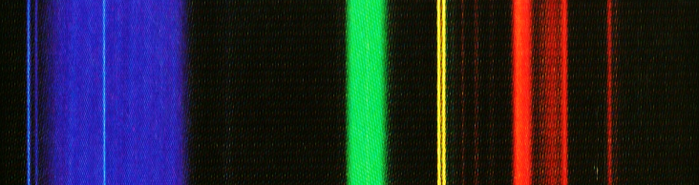
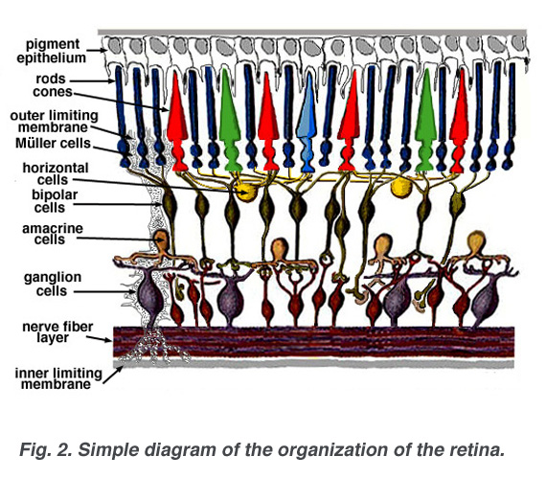
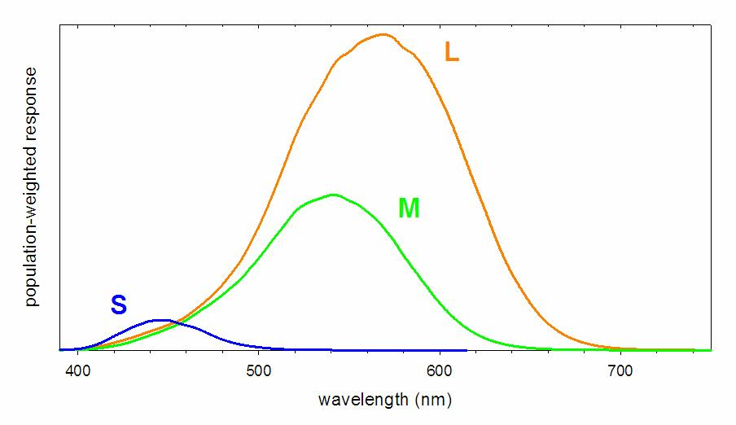
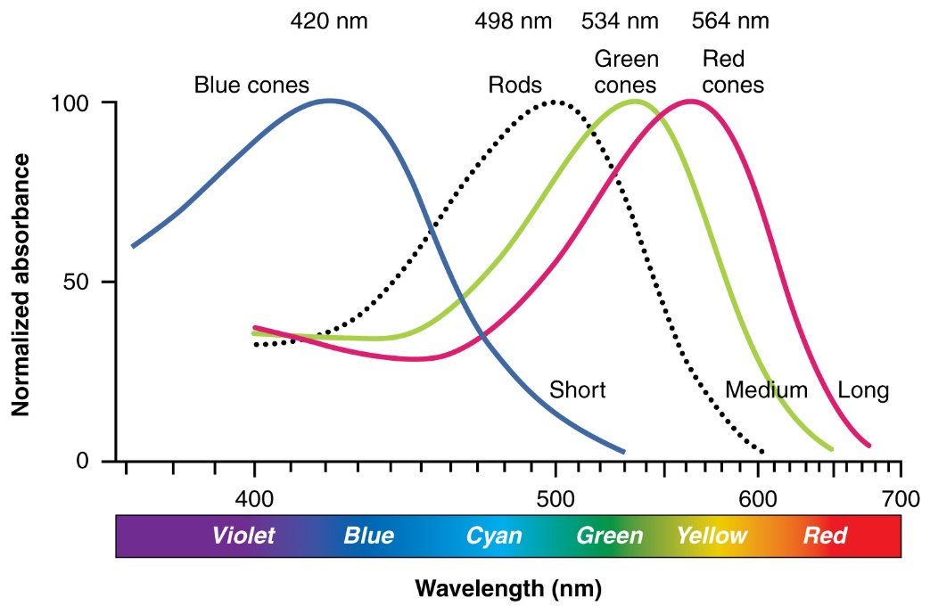

Slide 3
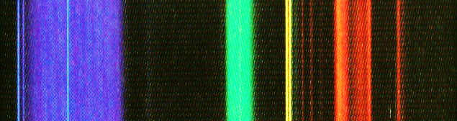
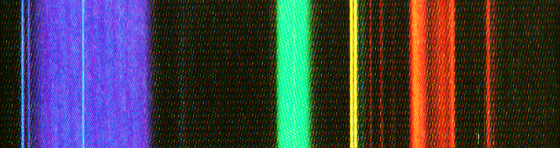
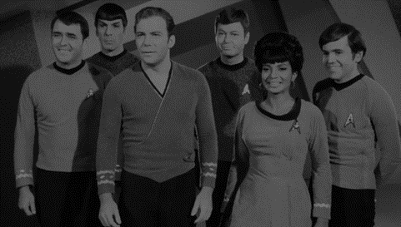
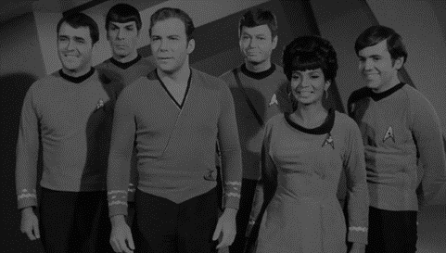
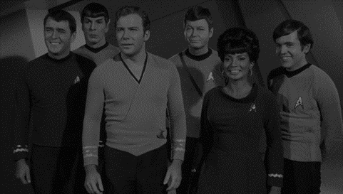
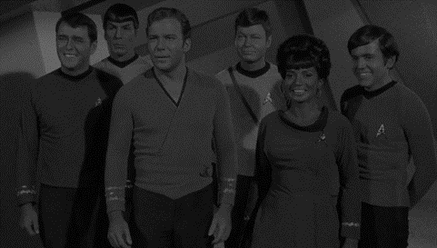

Slide 4

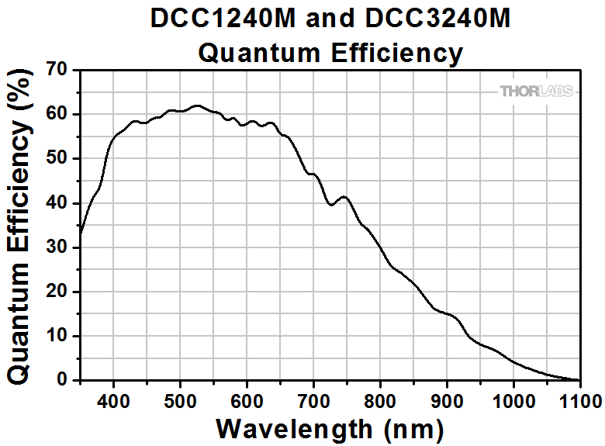
Single “Pixel”
in Scene
Spectrum Filtered
by N_{F} Filters
Spectrum Filtered
by Lens
Camera
Spectral Sensitivity
One value
(per pixel) per Filter
x [ N_{S} x 1 ]
F [ N_{F} x N_{S} ]
l [ N_{S} x 1 ]
s [ N_{S} x 1 ]
y [ N_{F} x 1 ]
y = F D{l} D{s} x

Slide 5
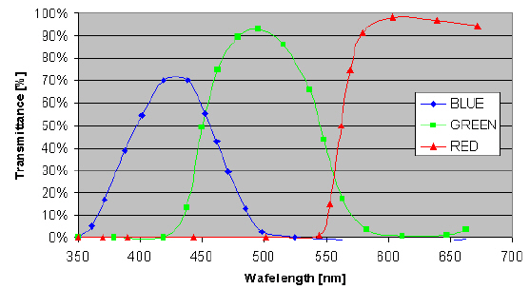
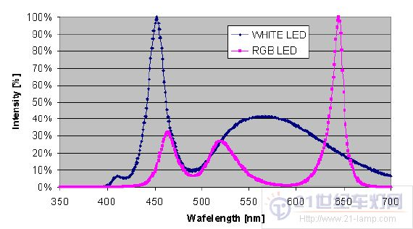
One value
(per pixel) per Filter
???
Single Pixel (RGB)
Values
LCD Screen
RGB Filters
LCD
Backlight Spectrum
y [ N_{F} x 1 ]
A [ 3 x N_{F} ]
z [ 3 x 1 ]
L [ N_{S} x 3 ]
b [ N_{S} x 1 ]
z = A y
x_{out} = D{b} L z
x_{out} ≈ D{b} L A F D{l} D{s} x

Slide 6
x_{out} ≈ D{b} L A F D{l} D{s} x
I ≈ D{b} L A F D{l} D{s}
D⁻¹{b} ≈ L A F D{l} D{s}
D⁻¹{b} D⁻¹{l} D⁻¹{s} ≈ L A F
(L^{T} L) ⁻¹L^{T} D⁻¹{b} D⁻¹{l} D⁻¹{s} ≈ A F
(L^{T} L) ⁻¹L^{T} D⁻¹{b} D⁻¹{l} D⁻¹{s} F^{T} (FF^{T} ) ⁻¹ ≈ A
(L^{T} L+D{ε}) ⁻¹L^{T} D⁻¹{b} D⁻¹{l} D⁻¹{s} F^{T} (FF^{T} +D{ε}) ⁻¹ ≈ A
(L^{T} L+D{ε}) ⁻¹L^{T} D{1./(b.*l.*s+ε)} F^{T} (FF^{T} +D{ε}) ⁻¹ ≈ A
Notes:
pseudo-inverse of L bc it’s not really square
regularization with D{E} – makes L and A invertible
epsilon is a touchy value, play with it

